Slide 1
Cache Memory
COAL FALL 2019
Noshaba Nasir

Slide 2
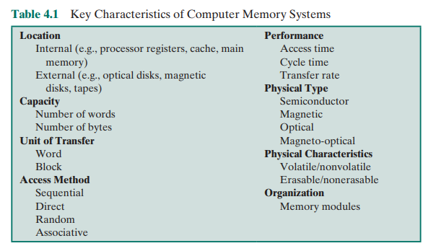
Characteristics of Memory Systems

Slide 3
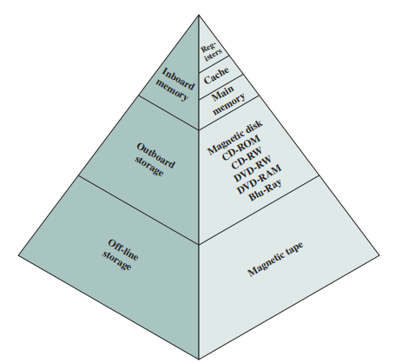
Memory Hierarchy

Slide 4
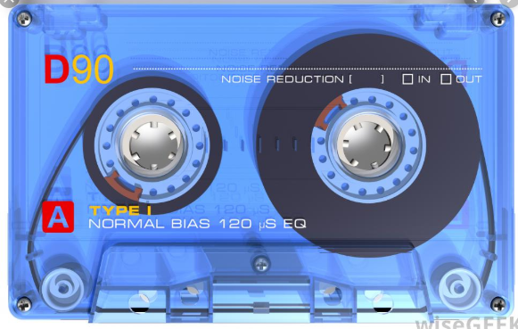
Example of Sequential Access

Slide 5
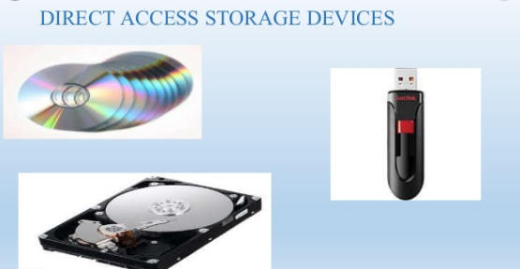
Example of Direct Access

Slide 6
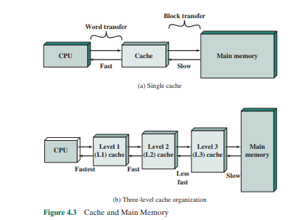
CACHE MEMORY PRINCIPLES
Cache memory is designed to combine the memory access time of expensive, highspeed memory combined with the large memory size of less expensive, lower-speed memory.
The cache contains a copy of portions of main memory.
When the processor attempts to read a word of memory, a check is made to determine if the word is in the cache.
If so, the word is delivered to the processor.
If not, a block of main memory, consisting of some fixed number of words, is read into the cache and then the word is delivered to the processor.
Because of the phenomenon of locality of reference, when a block of data is fetched into the cache to satisfy a single memory reference, it is likely that there will be future references to that same memory location or to other words in the block

Slide 7
CACHE MEMORY PRINCIPLES
Cache hit
copy is in cache, quick access
Cache miss
copy not in cache, read address and possibly its neighbors into cache

Slide 8
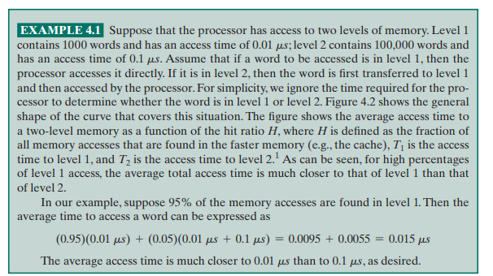
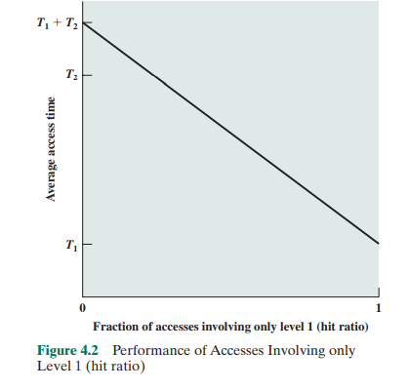
Average Access Time

Slide 9
Average Access Time
Question:
Consider a 3 level memory. It takes 0.001us to read from level 1, 0.01us to read from level 2 and 0.1us from level 3.
Data is found in L1 80% of time, out the remaining 20% of time 15% it is found in L2 and 5% data is to be read from L3.
What is the average access time?

Slide 10
Average Access Time
Question:
Consider a 3 level memory. It takes 0.001us to read from level 1, 0.01us to read from level 2 and 0.1us from level 3.
Data is found in L1 80% of time, out the remaining 20% of time 15% it is found in L2 and 5% data is to be read from L3.
What is the average access time?
Answer:
Average Access time= 80%(0.001)+ 15%(0.01+0.001)+ 5%(0.1+0.01+0.001)=0.008

Slide 11
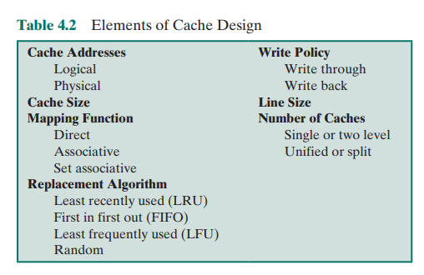
Elements of Cache Design

Slide 12
Cache Structure
Index: A number to each block/cell of cache
Tag: Used to keep complete or part of address of data the was brought from main memory
Data: To keep data brought from RAM
Value Bit: A single bit use to show if the data is updated after bringing it in from RAM
Index | Tag | Data | Value Bit
0
1
2
N

Slide 13
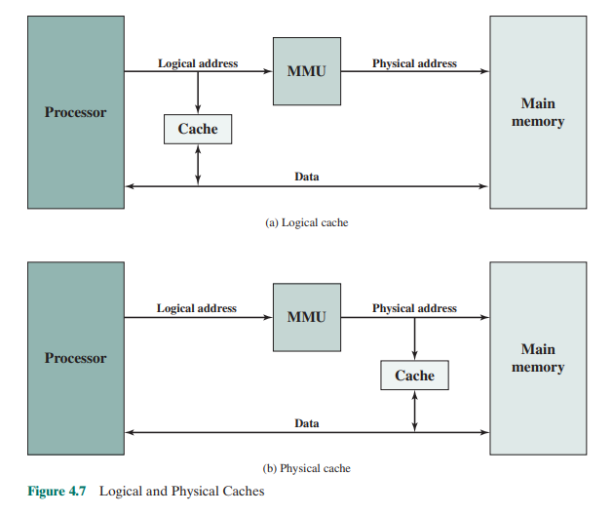
Cache Addressing
Logical caches that take Logical address is input
Physical Caches that takes Physical Address is input

Slide 14
Cache Size
Small enough so that the overall average cost per bit is close to that of main memory alone
Large enough so that the overall average access time is close to that of the cache alone
There are several other motivations for minimizing cache size.
The larger the cache, the larger the number of gates involved in addressing the cache. The result is that large caches tend to be slightly slower than small ones—even when built with the same integrated circuit technology and put in the same place on chip and circuit board.
The available chip and board area also limits cache size. Because the performance of the cache is very sensitive to the nature of the workload, it is impossible to arrive at a single “optimum” cache size.
Table 4.3 lists the cache sizes of some current and past processors.

Slide 15
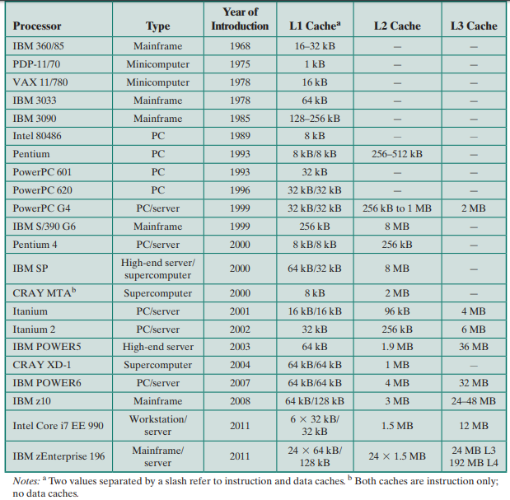
Table 4.3 Cache Sizes of Some Processors

Slide 16
Mapping Function
Because there are fewer cache lines than main memory blocks, an algorithm is needed for mapping main memory blocks into cache lines. Further, a means is needed for determining which main memory block currently occupies a cache line.
The choice of the mapping function dictates how the cache is organized. Three techniques can be used:
Direct
Associative
Set-associative

Slide 17
Associative Mapping
Any cell of main memory can be loaded in any cell of Cache
Addresses of RAM are stored as Tag
The cache control logic must simultaneously examine every tag for a match
Pros:
Flexibility
Cons:
Larger value of tag
Number of bits required for tag= log2(size of RAM)
For 1MB RAM tag size is of 20 bits

Slide 18
Address | Word
0000 | A
0001 | B
0010 | C
0011 | D
0100 | E
0101 | F
0110 | G
0111 | H
1000 | I
1001 | J
1010 | K
1011 | L
1100 | M
1101 | N
1110 | O
1111 | P
Index | Tag | Data | Value Bit
0
1
2
3
Cache
Main Memory

Slide 19
Read 0000
It’s a miss
Address | Word
0000 | A
0001 | B
0010 | C
0011 | D
0100 | E
0101 | F
0110 | G
0111 | H
1000 | I
1001 | J
1010 | K
1011 | L
1100 | M
1101 | N
1110 | O
1111 | P
Index | Tag | Data | Value Bit
0
1
2
3
Cache
Main Memory

Slide 20
Bring 0000 to Cache
Address | Word
0000 | A
0001 | B
0010 | C
0011 | D
0100 | E
0101 | F
0110 | G
0111 | H
1000 | I
1001 | J
1010 | K
1011 | L
1100 | M
1101 | N
1110 | O
1111 | P
Index | Tag | Data | Value Bit
0 | 0000 | A | 0
1
2
3
Cache
Main Memory

Slide 21
Read 0011
It’s a miss
Address | Word
0000 | A
0001 | B
0010 | C
0011 | D
0100 | E
0101 | F
0110 | G
0111 | H
1000 | I
1001 | J
1010 | K
1011 | L
1100 | M
1101 | N
1110 | O
1111 | P
Index | Tag | Data | Value Bit
0 | 0000 | A | 0
1
2
3
Cache
Main Memory

Slide 22
Bring 0011 to cache
Address | Word
0000 | A
0001 | B
0010 | C
0011 | D
0100 | E
0101 | F
0110 | G
0111 | H
1000 | I
1001 | J
1010 | K
1011 | L
1100 | M
1101 | N
1110 | O
1111 | P
Index | Tag | Data | Value Bit
0 | 0000 | A | 0
1 | 0011 | D | 0
2
3
Cache
Main Memory

Slide 23
Read 1000
It’s a miss
Address | Word
0000 | A
0001 | B
0010 | C
0011 | D
0100 | E
0101 | F
0110 | G
0111 | H
1000 | I
1001 | J
1010 | K
1011 | L
1100 | M
1101 | N
1110 | O
1111 | P
Index | Tag | Data | Value Bit
0 | 0000 | A | 0
1 | 0011 | D | 0
2 | 1000 | I | 0
3
Cache
Main Memory

Slide 24
Read 1000
It’s a miss
Address | Word
0000 | A
0001 | B
0010 | C
0011 | D
0100 | E
0101 | F
0110 | G
0111 | H
1000 | I
1001 | J
1010 | K
1011 | L
1100 | M
1101 | N
1110 | O
1111 | P
Index | Tag | Data | Value Bit
0 | 0000 | A | 0
1 | 0011 | D | 0
2
3
Cache
Main Memory

Slide 25
Bring 1010 to cache
Address | Word
0000 | A
0001 | B
0010 | C
0011 | D
0100 | E
0101 | F
0110 | G
0111 | H
1000 | I
1001 | J
1010 | K
1011 | L
1100 | M
1101 | N
1110 | O
1111 | P
Index | Tag | Data | Value Bit
0 | 0000 | A | 0
1 | 0011 | D | 0
2 | 1000 | I | 0
3 | 1010 | K | 0
Cache
Main Memory

Slide 26
Read 1110
It’s a miss, there is no space in cache so we replace least recently used element
(i.e 0000)
Address | Word
0000 | A
0001 | B
0010 | C
0011 | D
0100 | E
0101 | F
0110 | G
0111 | H
1000 | I
1001 | J
1010 | K
1011 | L
1100 | M
1101 | N
1110 | O
1111 | P
Index | Tag | Data | Value Bit
0 | 0000 | A | 0
1 | 0011 | D | 0
2 | 1000 | I | 0
3 | 1010 | K | 0
Cache
Main Memory

Slide 27
Bring 1110 in place of least recently used
Address | Word
0000 | A
0001 | B
0010 | C
0011 | D
0100 | E
0101 | F
0110 | G
0111 | H
1000 | I
1001 | J
1010 | K
1011 | L
1100 | M
1101 | N
1110 | O
1111 | P
Index | Tag | Data | Value Bit
0 | 1110 | O | 0
1 | 0011 | D | 0
2 | 1000 | I | 0
3 | 1010 | K | 0
Cache
Main Memory

Slide 28
Read 0000
It’s a miss
Cache is full so we replace the least recently used element (i.e 0011),
Address | Word
0000 | A
0001 | B
0010 | C
0011 | D
0100 | E
0101 | F
0110 | G
0111 | H
1000 | I
1001 | J
1010 | K
1011 | L
1100 | M
1101 | N
1110 | O
1111 | P
Index | Tag | Data | Value Bit
0 | 1110 | O | 0
1 | 0011 | D | 0
2 | 1000 | I | 0
3 | 1010 | K | 0
Cache
Main Memory

Slide 29
Bring 0000 in cache by replacing 0011
Note the now 0000 is on index 1
Address | Word
0000 | A
0001 | B
0010 | C
0011 | D
0100 | E
0101 | F
0110 | G
0111 | H
1000 | I
1001 | J
1010 | K
1011 | L
1100 | M
1101 | N
1110 | O
1111 | P
Index | Tag | Data | Value Bit
0 | 1110 | O | 0
1 | 0000 | A | 0
2 | 1000 | I | 0
3 | 1010 | K | 0
Cache
Main Memory

Slide 30
Read 0000
It’s a hit
Address | Word
0000 | A
0001 | B
0010 | C
0011 | D
0100 | E
0101 | F
0110 | G
0111 | H
1000 | I
1001 | J
1010 | K
1011 | L
1100 | M
1101 | N
1110 | O
1111 | P
Index | Tag | Data | Value Bit
0 | 1110 | O | 0
1 | 0000 | A | 0
2 | 1000 | I | 0
3 | 1010 | K | 0
Cache
Main Memory

Slide 31
Direct Mapping
Main Memory address is dived into 2 fields
Index = Main Memory Address% Size of Cache
Data is placed in cache at this index
Tag= Main Memory Address / Size of Cache
As stored in cache along with data
Main Memory Address= Tag*Size of Cache + Index

Slide 32
Address | Word
0000 | A
0001 | B
0010 | C
0011 | D
0100 | E
0101 | F
0110 | G
0111 | H
1000 | I
1001 | J
1010 | K
1011 | L
1100 | M
1101 | N
1110 | O
1111 | P
Index | Tag | Data | Value Bit
0
1
2
3
Cache
Main Memory

Slide 33
Read 0000b (0d)
The tag and index of this address is
Tag=00b Index=00b
It’s a miss
Address | Word
0000 | A
0001 | B
0010 | C
0011 | D
0100 | E
0101 | F
0110 | G
0111 | H
1000 | I
1001 | J
1010 | K
1011 | L
1100 | M
1101 | N
1110 | O
1111 | P
Index | Tag | Data | Value Bit
0
1
2
3
Cache
Main Memory

Slide 34
0000b (0d) will be placed on cache at index 00 and tag 00 will be stored
Address | Word
0000 | A
0001 | B
0010 | C
0011 | D
0100 | E
0101 | F
0110 | G
0111 | H
1000 | I
1001 | J
1010 | K
1011 | L
1100 | M
1101 | N
1110 | O
1111 | P
Index | Tag | Data | Value Bit
0 | 00 | A | 0
1
2
3
Cache
Main Memory

Slide 35
Read 0100b (4d)
The tag and index of this address is
Tag=01b Index=00b
It’s a miss
Address | Word
0000 | A
0001 | B
0010 | C
0011 | D
0100 | E
0101 | F
0110 | G
0111 | H
1000 | I
1001 | J
1010 | K
1011 | L
1100 | M
1101 | N
1110 | O
1111 | P
Index | Tag | Data | Value Bit
0 | 00 | A | 0
1
2
3
Cache
Main Memory

Slide 36
0100b (4d) will be placed on cache at index 00 and tag 01 will be stored
But index 00 already has some data, we will replace that
Note that even rest of the cache is free 0100 will go at index 00b
Address | Word
0000 | A
0001 | B
0010 | C
0011 | D
0100 | E
0101 | F
0110 | G
0111 | H
1000 | I
1001 | J
1010 | K
1011 | L
1100 | M
1101 | N
1110 | O
1111 | P
Index | Tag | Data | Value Bit
0 | 01 | E | 0
1
2
3
Cache
Main Memory

Slide 37
Question:
See the tag at index 2 of cache. What data is placed over there?
Address | Word
0000 | A
0001 | B
0010 | C
0011 | D
0100 | E
0101 | F
0110 | G
0111 | H
1000 | I
1001 | J
1010 | K
1011 | L
1100 | M
1101 | N
1110 | O
1111 | P
Index | Tag | Data | Value Bit
0 | 00 | A | 0
1 | 10 | J | 0
2 | 11 | ? | 0
3
Cache
Main Memory

Slide 38
Question:
See the tag at index 2 of cache. What data is placed over there?
Answer: O ie data of address 1110
Address | Word
0000 | A
0001 | B
0010 | C
0011 | D
0100 | E
0101 | F
0110 | G
0111 | H
1000 | I
1001 | J
1010 | K
1011 | L
1100 | M
1101 | N
1110 | O
1111 | P
Index | Tag | Data | Value Bit
0 | 00 | A | 0
1 | 10 | J | 0
2 | 11 | ? | 0
3
Cache
Main Memory

Slide 39
Read 1001 (9d)
The tag and index of this address is
Tag=10b Index=01b
It’s a miss
Address | Word
0000 | A
0001 | B
0010 | C
0011 | D
0100 | E
0101 | F
0110 | G
0111 | H
1000 | I
1001 | J
1010 | K
1011 | L
1100 | M
1101 | N
1110 | O
1111 | P
Index | Tag | Data | Value Bit
0 | 00 | A | 0
1
2
3
Cache
Main Memory

Slide 40
1001 will be placed on cache at index 01 and tag 10 will be stored
Address | Word
0000 | A
0001 | B
0010 | C
0011 | D
0100 | E
0101 | F
0110 | G
0111 | H
1000 | I
1001 | J
1010 | K
1011 | L
1100 | M
1101 | N
1110 | O
1111 | P
Index | Tag | Data | Value Bit
0 | 00 | A | 0
1 | 10 | J | 0
2
3
Cache
Main Memory

Slide 41
Direct Mapping
The size of tag will depend of size of cache and size of RAM
Number of bits required for tag= log2(size of Ram/ Size of Cache)
Number of bits required for index= log2(size of cache)
Tip:
Tagb:Indexb= Main Memory Address b

Slide 42
Direct Mapping
Question:
If cache is of 8 words and Ram of 16 words
What is the size of tag?
If cache is of 1k Words and Ram is of 1M words
What is the size of tag?

Slide 43
Direct Mapping
Question:
If cache is of 8 words and Ram of 16 words
What is the size of tag?
Answer log2(16/8)= 1
If cache is of 1k Words and Ram is of 1M words
What is the size of tag?
Answr = log 2(2^20/2^10)= 10

Slide 44
Set Associative Mapping
In direct Mapping two words with same index but different tags cannot reside in cache at same time
For figure given in slide 36, data of address 0000 and 0100 cannot reside in cache at same time
In set associative mapping there are multiple sets and words with same index but different tags can reside in cache at same time
If there are k sets then k elements with same index can reside in cache
All the sets are checked simultaneously to see if the data is in cache

Slide 45
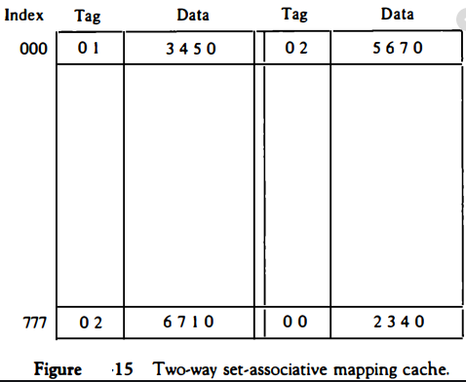
set 0 set 1

Slide 46
Address | Word
0000 | A
0001 | B
0010 | C
0011 | D
0100 | E
0101 | F
0110 | G
0111 | H
1000 | I
1001 | J
1010 | K
1011 | L
1100 | M
1101 | N
1110 | O
1111 | P
set 0 set 1
Index | Tag | Data | Value Bit | Tag | Data | Value Bit
0
1
2
3
Cache
Main Memory

Slide 47
Read 0000
Tag= 00 index =00
It’s a miss
Address | Word
0000 | A
0001 | B
0010 | C
0011 | D
0100 | E
0101 | F
0110 | G
0111 | H
1000 | I
1001 | J
1010 | K
1011 | L
1100 | M
1101 | N
1110 | O
1111 | P
set 0 set 1
Index | Tag | Data | Value Bit | Tag | Data | Value Bit
0
1
2
3
Cache
Main Memory

Slide 48
0000 will be placed it in index 00 and tag will be equal to 00
We place it in set because it was empty slot
Address | Word
0000 | A
0001 | B
0010 | C
0011 | D
0100 | E
0101 | F
0110 | G
0111 | H
1000 | I
1001 | J
1010 | K
1011 | L
1100 | M
1101 | N
1110 | O
1111 | P
set 0 set 1
Index | Tag | Data | Value Bit | Tag | Data | Value Bit
0 | 00 | A | 0
1
2
3
Cache
Main Memory

Slide 49
Read 0100
Tag= 01 index =00
It’s a miss
Address | Word
0000 | A
0001 | B
0010 | C
0011 | D
0100 | E
0101 | F
0110 | G
0111 | H
1000 | I
1001 | J
1010 | K
1011 | L
1100 | M
1101 | N
1110 | O
1111 | P
set 0 set 1
Index | Tag | Data | Value Bit | Tag | Data | Value Bit
0 | 00 | A | 0 | 01 | E | 0
1
2
3
Cache
Main Memory

Slide 50
0100 will be placed it in index 00 and tag will be 01
We place it in set 1 because it was empty slot
Address | Word
0000 | A
0001 | B
0010 | C
0011 | D
0100 | E
0101 | F
0110 | G
0111 | H
1000 | I
1001 | J
1010 | K
1011 | L
1100 | M
1101 | N
1110 | O
1111 | P
set 0 set 1
Index | Tag | Data | Value Bit | Tag | Data | Value Bit
0 | 00 | A | 0 | 01 | E | 0
1
2
3
Cache
Main Memory

Slide 51
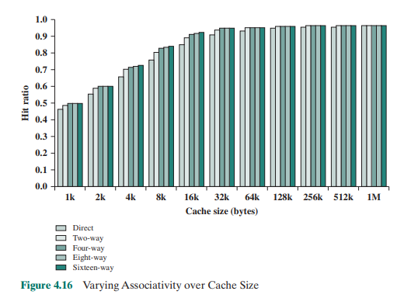

Slide 52
Replacement Algorithms
Once the cache has been filled, when a new block is brought into the cache, one of the existing blocks must be replaced.
For direct mapping, there is only one possible line for any particular block, and no choice is possible.
For the associative and set associative techniques, a replacement algorithm is needed.
To achieve high speed, such an algorithm must be implemented in hardware

Slide 53
Replacement Algorithm (LRU)
Probably the most effective is least recently used (LRU):
Replace that block in the set that has been in the cache longest with no reference to it.
For two-way set associative, this is easily implemented.
Each line includes a USE bit. When a line is referenced, its USE bit is set to 1 and the USE bit of the other line in that set is set to 0.
When a block is to be read into the set, the line whose USE bit is 0 is used.
Because we are assuming that more recently used memory locations are more likely to be referenced, LRU should give the best hit ratio.
LRU is also relatively easy to implement for a fully associative cache.
The cache mechanism maintains a separate list of indexes to all the lines in the cache.
When a line is referenced, it moves to the front of the list.
For replacement, the line at the back of the list is used.
Because of its simplicity of implementation, LRU is the most popular replacement algorithm.

Slide 54
Other Replacement Policies
First-in-first-out (FIFO):
Replace that block in the set that has been in the cache longest.
FIFO is easily implemented as a round-robin or circular buffer technique.
Least frequently used (LFU):
Replace that block in the set that has experienced the fewest references.
LFU could be implemented by associating a counter with each line.
Random Replacement
Pick a line at random from among the candidate lines.
Simulation studies have shown that random replacement provides only slightly inferior performance to an algorithm based on usage [SMIT82].

Slide 55
Write Policy
When a block that is resident in the cache is to be replaced, there are two cases to consider.
If the old block in the cache has not been altered, then it may be overwritten with a new block without first writing out the old block.
If at least one write operation has been performed on a word in that line of the cache, then main memory must be updated by writing the line of cache out to the block of memory before bringing in the new block.

Slide 56
Writing Policy
The simplest technique is called write through.
Using this technique, all write operations are made to main memory as well as to the cache, ensuring that main memory is always valid.
Disadvantage of this technique is that it generates substantial memory traffic and may create a bottleneck.
An alternative technique, known as write back, minimizes memory writes.
With write back, updates are made only in the cache.
When an update occurs, a dirty bit, or value bit, associated with the line is set.
When a block is replaced, it is written back to main memory if and only if the dirty bit is set.
The problem with write back is that portions of main memory are invalid, and hence accesses by I/O modules can be allowed only through the cache.

Slide 57
Exercise

Slide 58
Question
Consider a cache that can store 4 words,
Consider a Main Memory of 64 words
For the following addresses of RAM accesses, find the hits and misses using direct mapping:
10,12,10,12,63,58,34,10,34,63, 33,10, 63

Slide 59
Question
Consider a cache that can store 4 words,
Consider a Main Memory of 64 words
LRU is used as replacement policy.
For the following addresses of RAM accesses, find the hits and misses using associative mapping:
10,12,10,12,63,58,34,10,34,63, 33,10, 63

Slide 60
Question
Consider a cache that can store 4 words,
Consider a Main Memory of 64 words
LRU is used as replacement policy.
For the following addresses of RAM accesses, find the hits and misses using 2 way set associative mapping:
10,12,10,12,63,58,34,10,34,63,33,10, 63

Slide 61
References
William Stalling chapter 4 Cache Memory Section 4.1, 4.2, 4.3
http://upscfever.com/upsc-fever/en/gatecse/en-gatecse-chp167.html
http://www.mathcs.emory.edu/~cheung/Courses/355/Syllabus/8-cache/dm.html

